Slide 1
Program Name goes here
Link to github Repository: GitHub
Links to trello board / project management tools: Trello Board
You MUST provide evidence showing how the problem has been decomposed, how the components have been developed and trialled, and of how they have been assembled and tested to create a final, working outcome.

Slide 2
Relevant Implications
Explain the relevant implications here. Please watch this video to learn how to do this.
Notes:
Explain the relevant implications here. Then as you work, develop your code, discuss how the implications are being met.

Slide 3
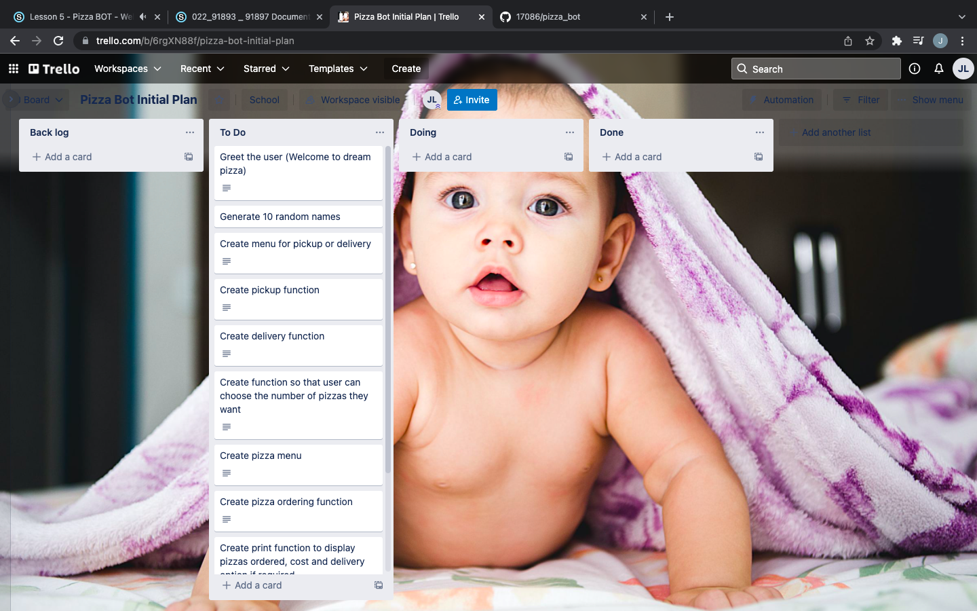
Decomposition
Notes:
Paste screenshots of your initial Trello board / task decomposition on this slide. If you have a long list, you might need to break it up into several columns. Delete this instruction when you are done.

Slide 4
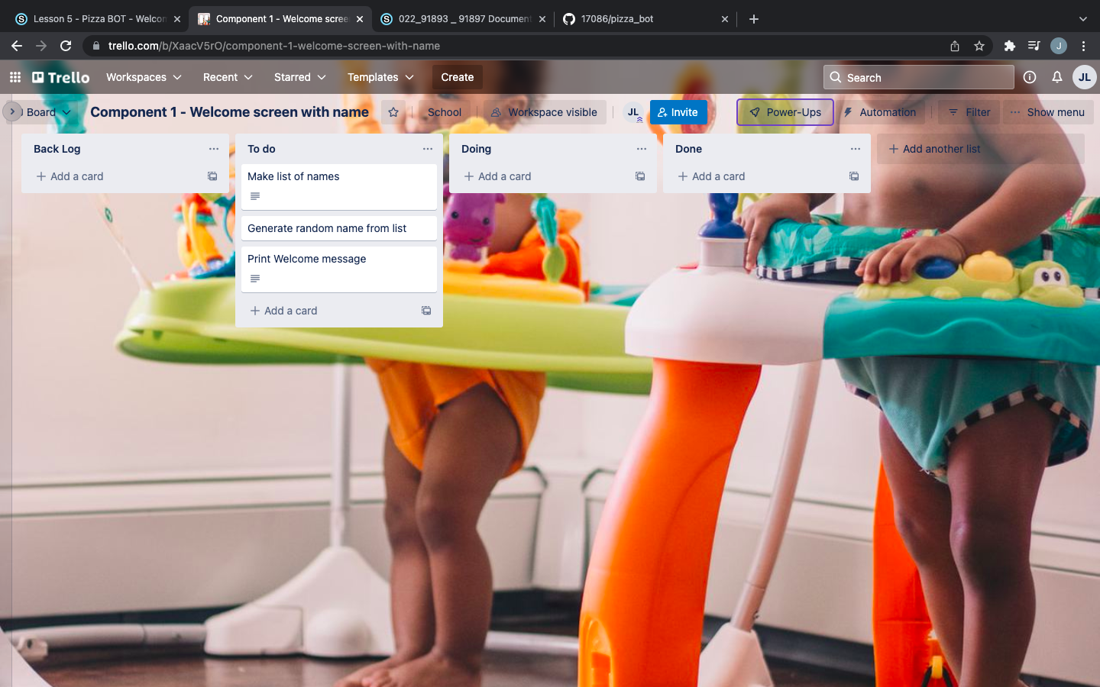
Component 1 (Trello screenshot)
Version 2
Version1

Slide 5
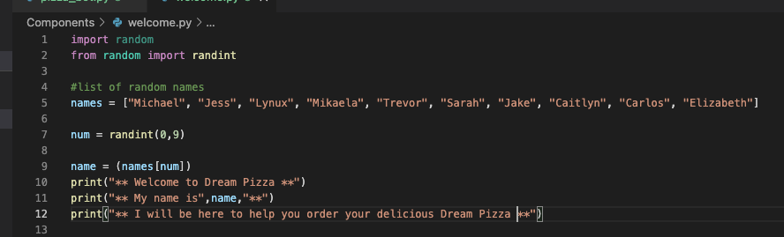
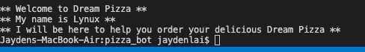
Component 1 - Test Plan (?and screenshot)
Test Case | Expected Values
Run Program | Print welcome message with random name from list of names – runs correctly

Slide 6
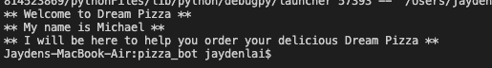
Component 1 Version 2 - Test Plan (?and screenshot)
Test Case | Expected Values
Run Program | Main and welcome run correctly. Welcome message prints with random name

Slide 7
Component 1 Version 2 - Test Plan (?and screenshot)
Test Case | Expected Values
Run Program | Print welcome message with random name from list of names – runs correctly

Slide 8
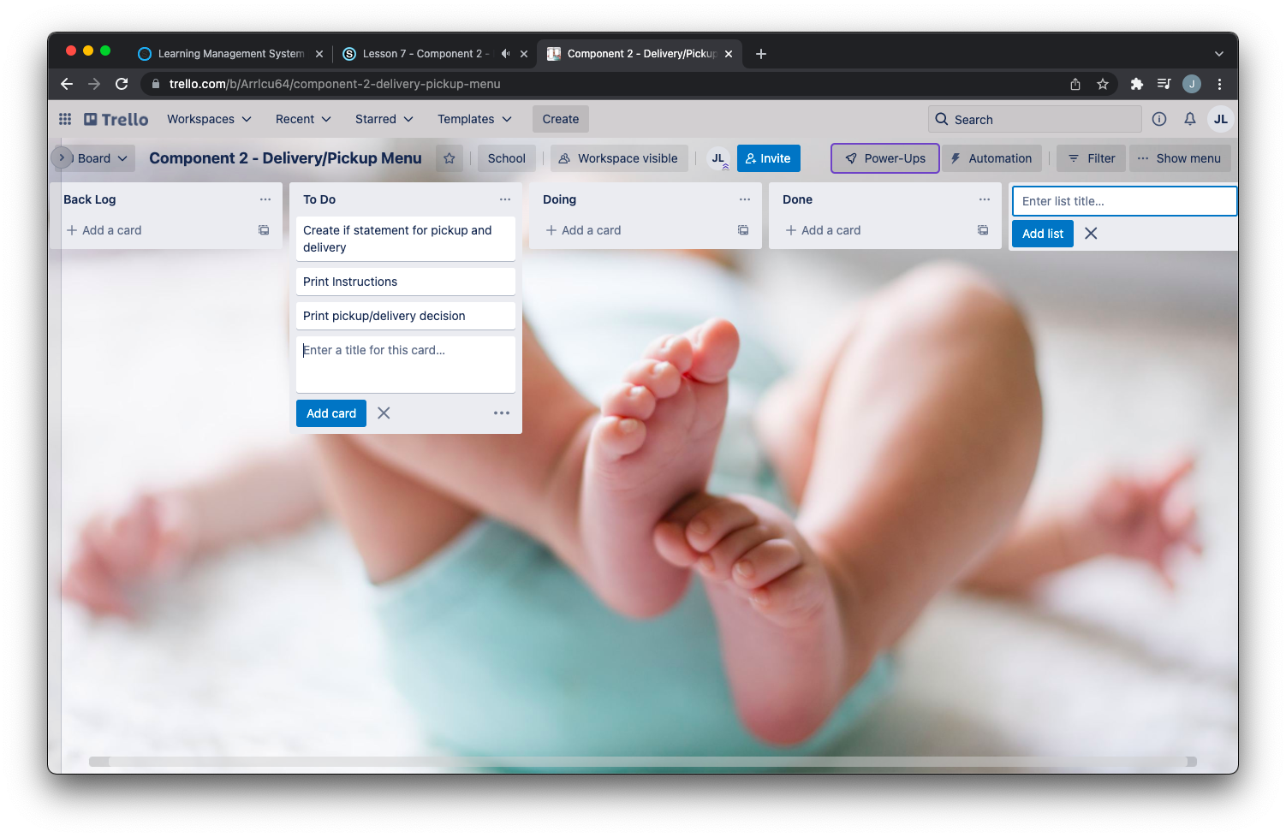
Component 2 (Trello screenshot)

Slide 9
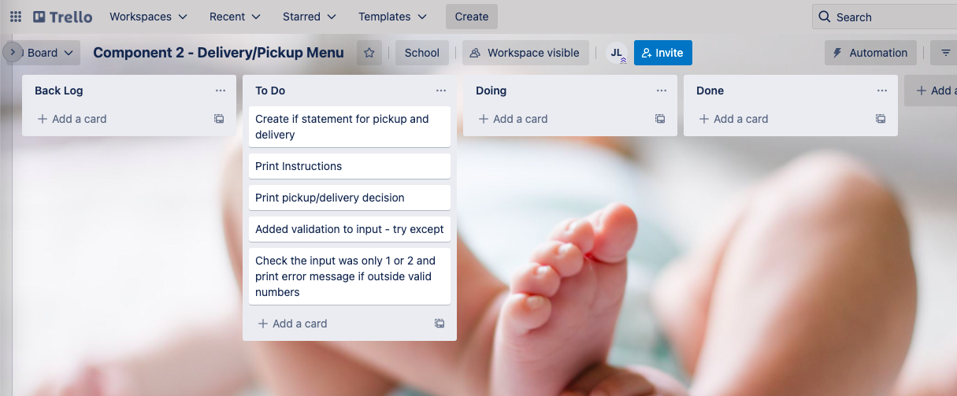
Component 2 Version 2 (Trello screenshot)

Slide 10
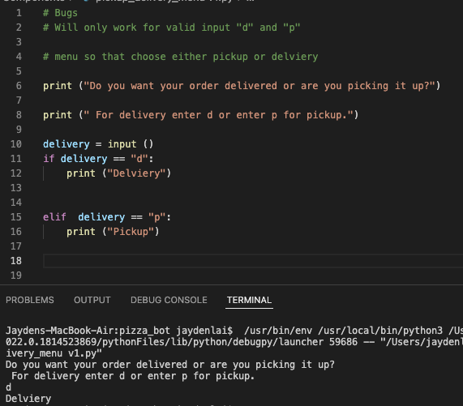
Component 2 Version 1- Test Plan (?and screenshot)
Test Case | Expected Values
Run Program | Enter p program prints pickup Enter d program prints delivery Enter invalid program prints nothing

Slide 11
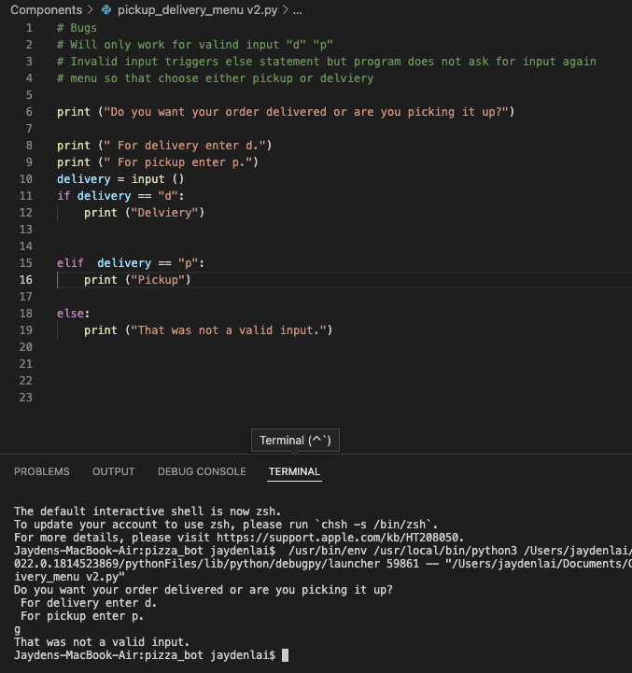
Component 2 Version 2- Test Plan (?and screenshot)
Test Case | Expected Values
Run Program | Enter p program prints pickup Enter d program prints delivery Enter invalid program prints error message

Slide 12
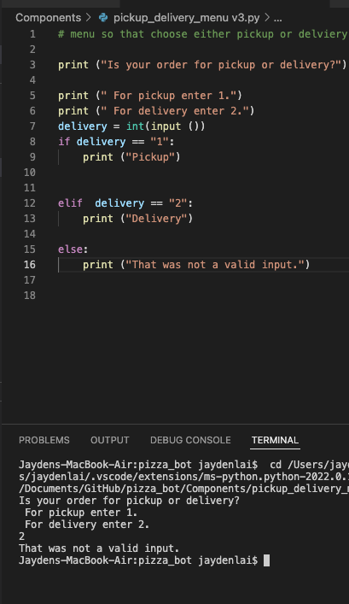
Component 2 Version 3- Test Plan (?and screenshot)
Test Case | Expected Values
Run Program | Enter 1 program prints pickup Enter 2 program prints delivery Enter invalid program displays value error

Slide 13
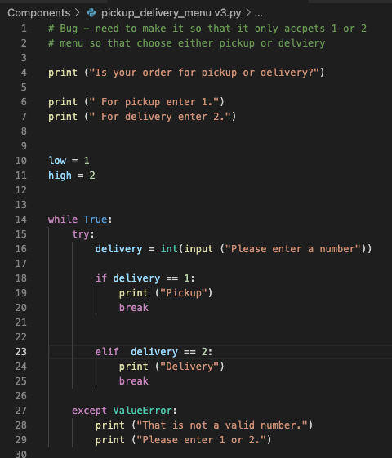
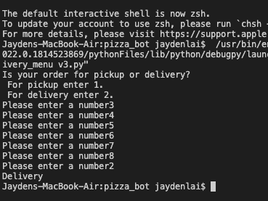
Component 2 Version 4- Test Plan (?and screenshot)
Test Case | Expected Values
Run Program | Enter 1 program prints pickup Enter 2 program prints delivery Enter invalid program prints error message Enter number other than 1 or 2 does not work

Slide 14
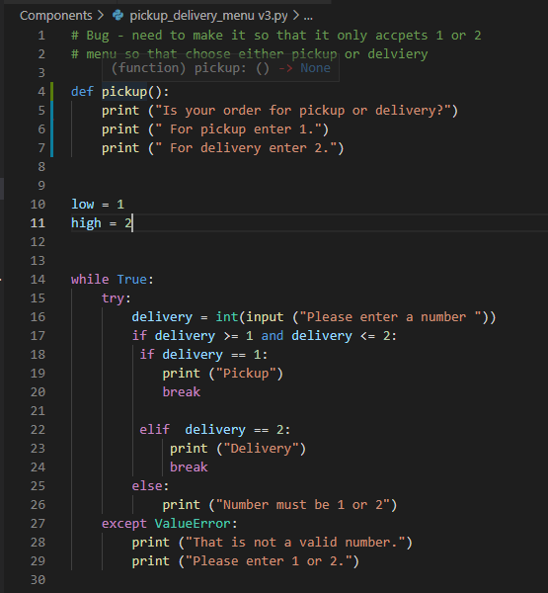
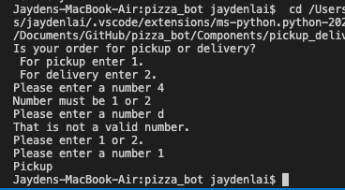
Component 2 Version 5- Test Plan (?and screenshot)
Test Case | Expected Values
Run Program | Enter 1 program prints pickup Enter 2 program prints delivery Enter invalid program prints error message Enter number other than 1 or 2 – error message asks for entry again

Slide 15
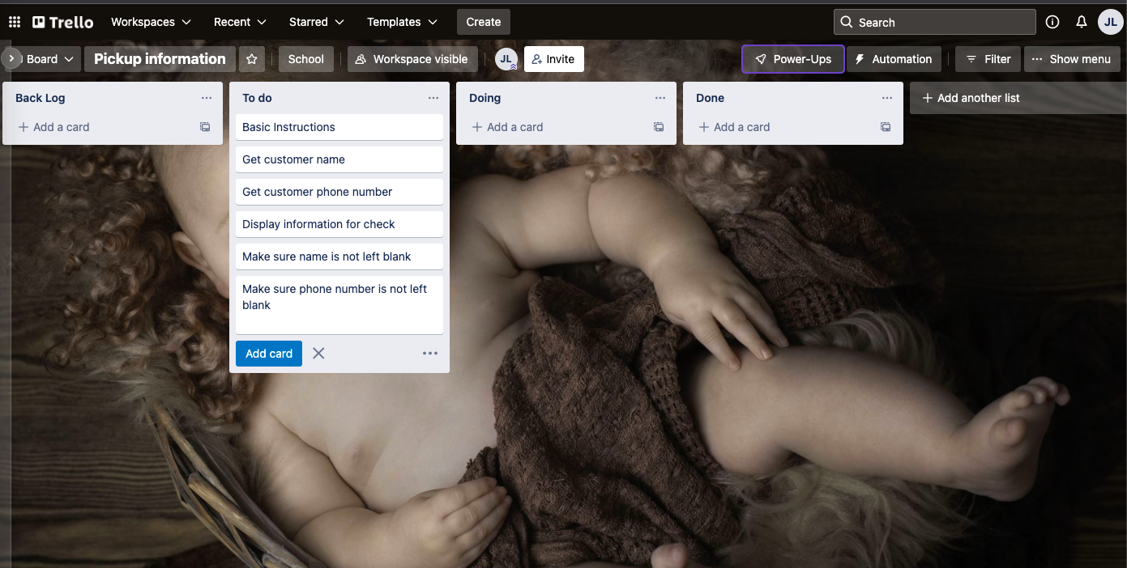
Component 3 Pickup info (Trello screenshot)

Slide 16
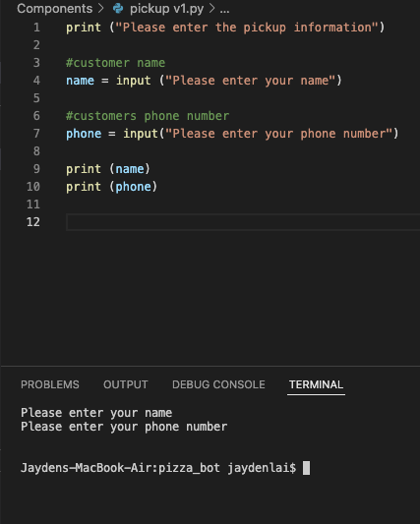
Component 3 Version 1- Test Plan (?and screenshot)
Test Case | Expected Values
Input name Input phone number Left input blank | Printed name correctly Printed phone number Accepted blank and printed blank input

Slide 17
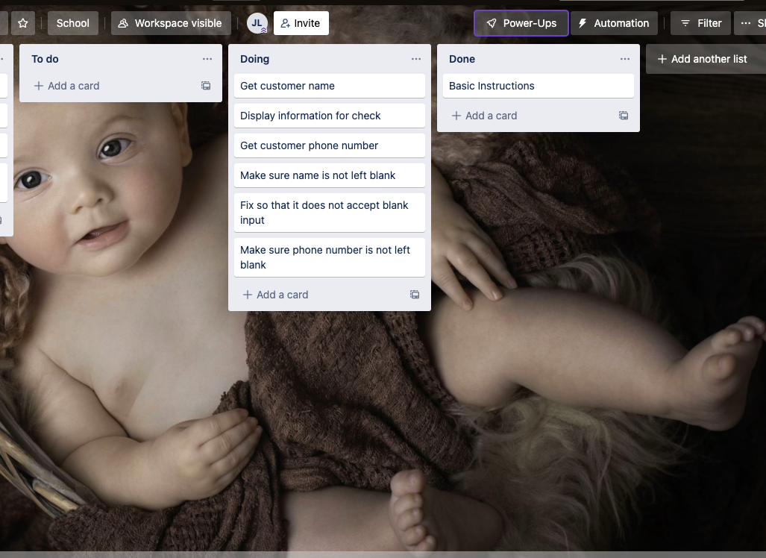
Component 3 v2 Pickup info (Trello screenshot)

Slide 18
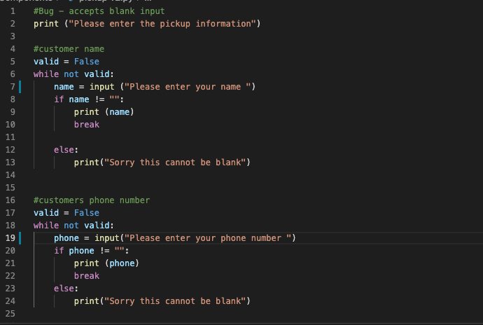
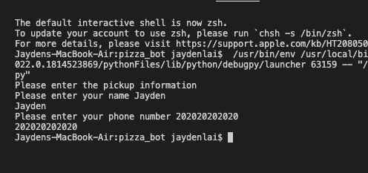
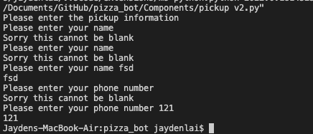
Component 3 v2- Test Plan (?and screenshot)
Test Case | Expected Values
Input name Input phone number Left input blank | Printed name correctly Printed phone number Prints “Sorry this cannot be blank” – goes back to input

Slide 19
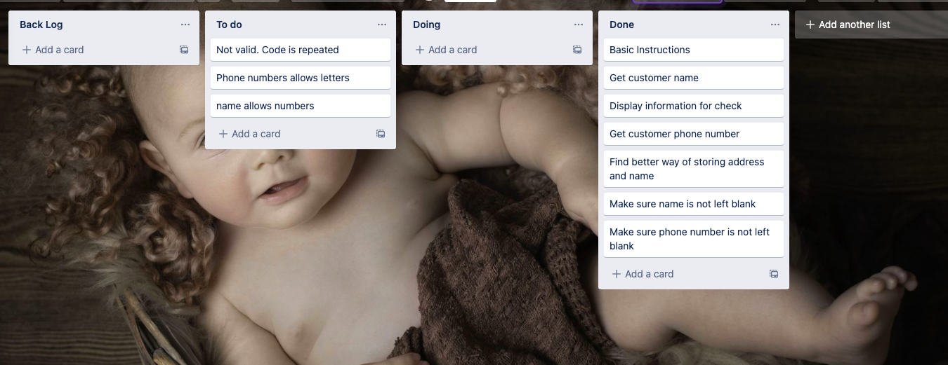
Component 3 v3 Pickup info (Trello screenshot)

Slide 20
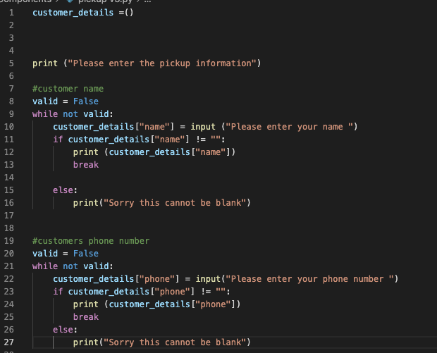
Component 3 v3- Test Plan (?and screenshot)
Test Case | Expected Values
Input name Input phone number Left input blank | Printed name correctly Printed phone number Prints “Sorry this cannot be blank” – goes back to input

Slide 21
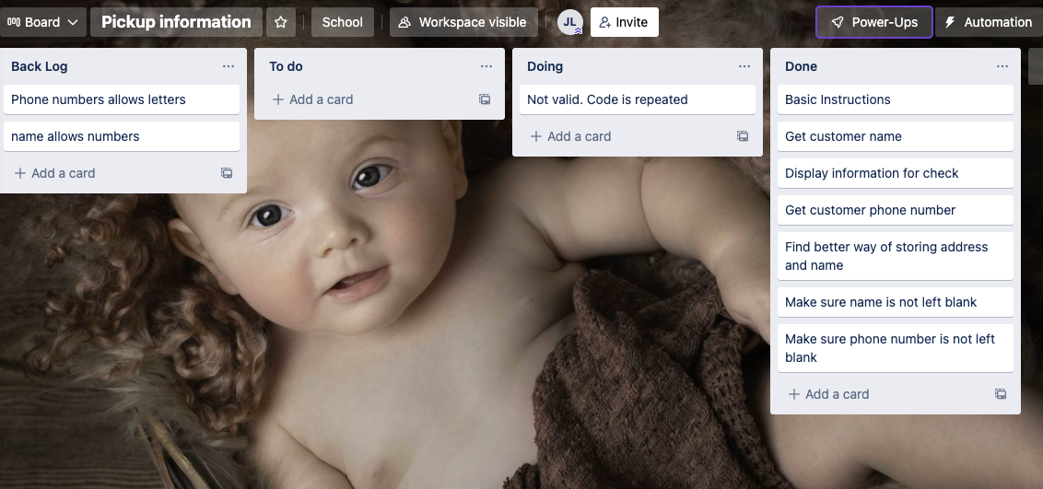
Component 3 v5 Pickup info (Trello screenshot)

Slide 22
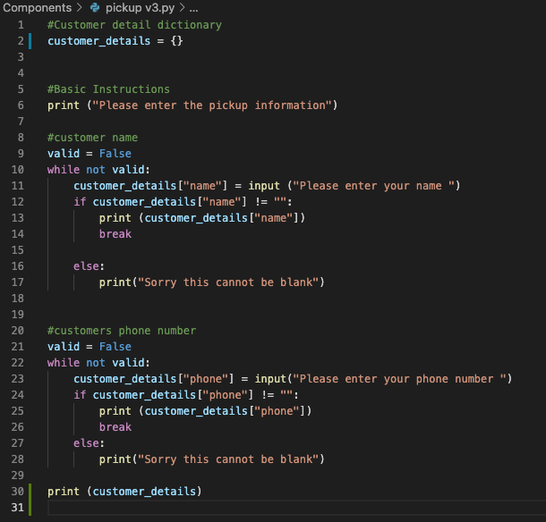
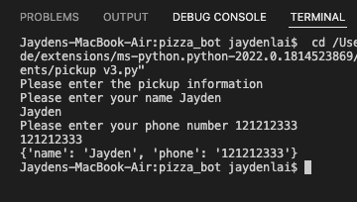
Component 3 v5- Test Plan (?and screenshot)
Test Case | Expected Values
Input name Input phone number Left input blank | Printed name correctly Printed phone number Prints “Sorry this cannot be blank” – goes back to input

Slide 23
Component 3 v6 Pickup info (Trello screenshot)

Slide 24
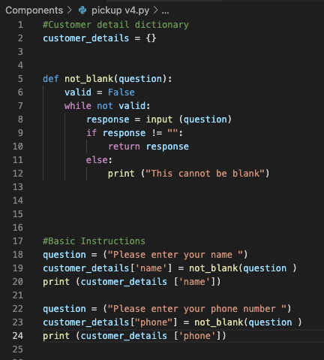
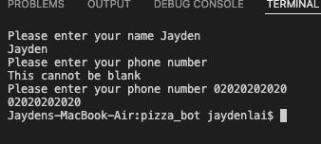
Component 3 v6- Test Plan (?and screenshot)
Test Case | Expected Values
Input name Input phone number Left input blank | Printed name correctly Printed phone number Prints “Sorry this cannot be blank” – goes back to input

Slide 25
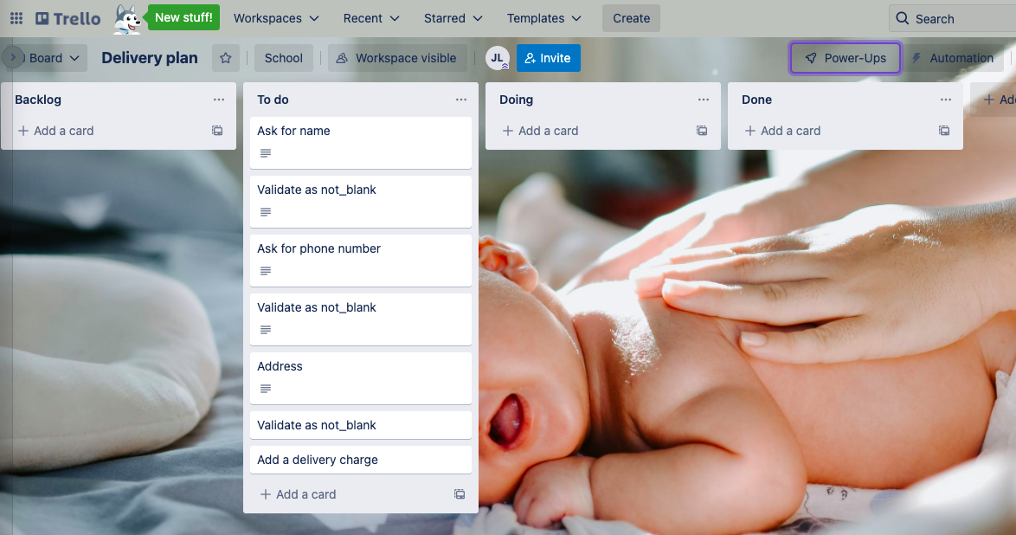
Component 4 v1 Delivery info (Trello screenshot)

Slide 26
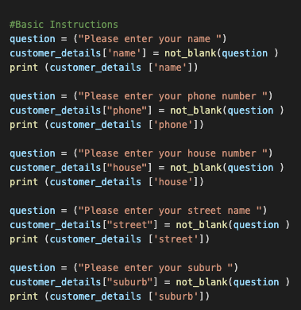
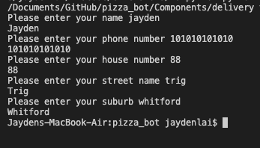
Component 4 v1- Test Plan
Test Case | Expected Values
Input name Input phone number Input house number Input street name Input suburb Left input blank | Printed name correctly Printed phone number Prints “Sorry this cannot be blank” – goes back to input Printed house number Printed street name Printed suburb Asked for input again

Slide 27
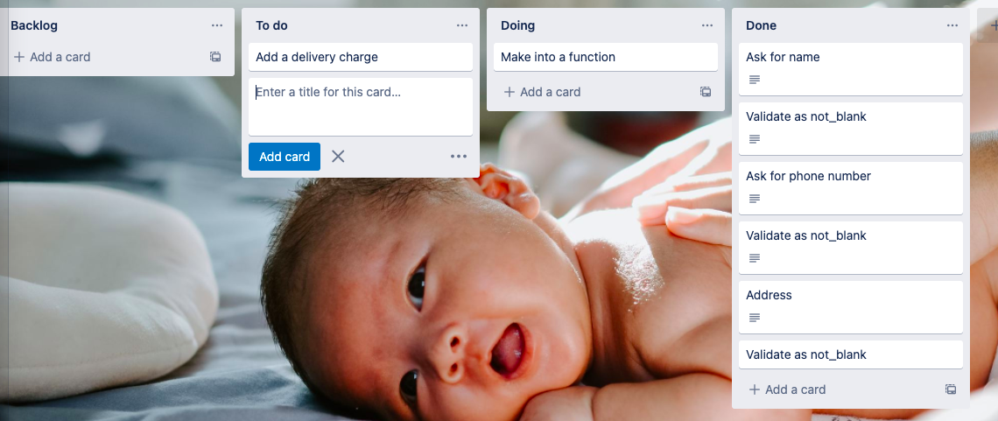
Component 4 v2 Delivery info (Trello screenshot)

Slide 28
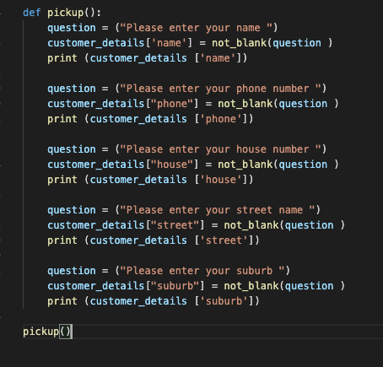
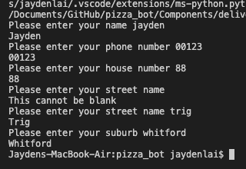
Component 4 v2- Test Plan
Test Case | Expected Values
Input name Input phone number Input house number Input street name Input suburb Left input blank | Printed name correctly Printed phone number Printed house number Printed street name Printed suburb Asked for input again Prints “Sorry this cannot be blank” – goes back to input

Slide 29
Component 4 v2 Delivery info (Trello screenshot)

Slide 30
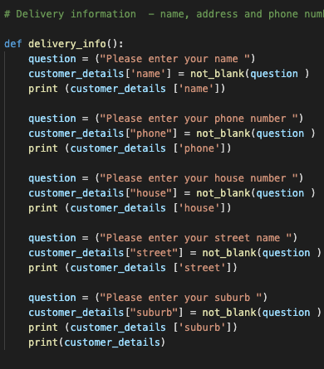
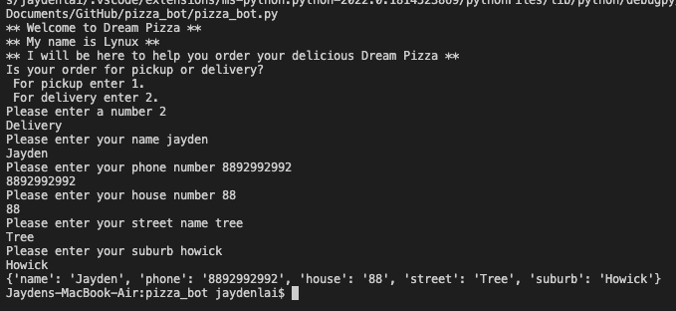
Component 4 v2- Test Plan
Test Case | Expected Values
Input name Input phone number Input house number Input street name Input suburb Left input blank | Printed name correctly Printed phone number Printed house number Printed street name Printed suburb Asked for input again Prints “Sorry this cannot be blank” – goes back to input

Slide 31
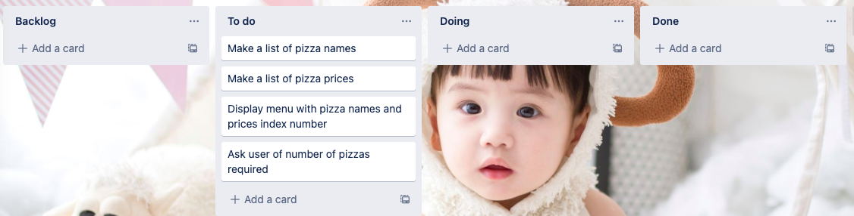
Component 5 Pizza menu (Trello screenshot)

Slide 32
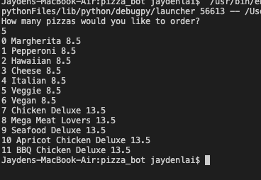
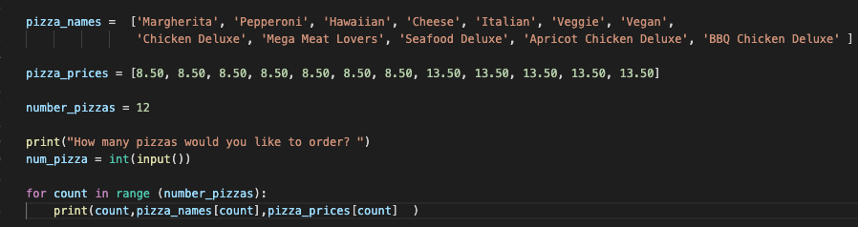
Component 5 v1- Test Plan
Test Case | Expected Values
Run file | Printed a list with index number, pizzas and prices

Slide 33
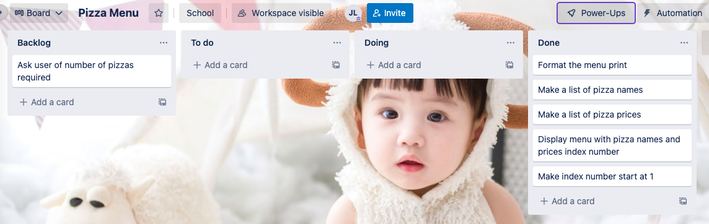
Component 5 v2 Pizza menu (Trello screenshot)

Slide 34
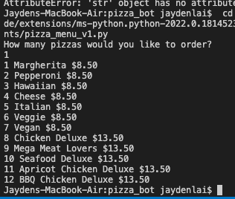
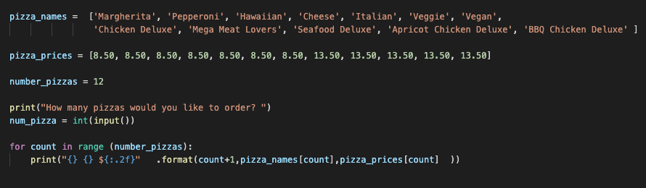
Component 5 v2- Test Plan
Test Case | Expected Values
Run file | Printed a list with index number, pizzas and prices With price formatted to 2 decimal places and dollar sign. Menu starts at 1.

Slide 35
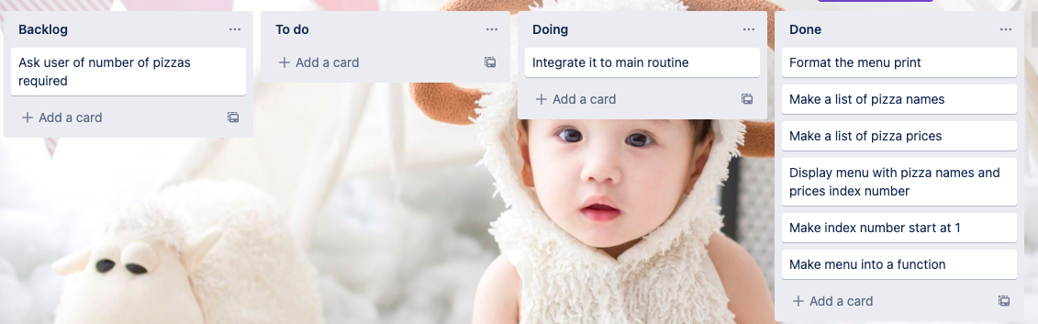
Component 5 v3 Pizza menu (Trello screenshot)

Slide 36
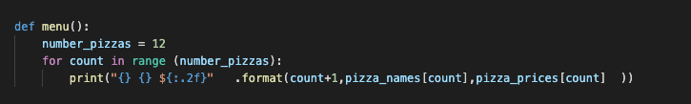
Component 5 v3- Test Plan
Test Case | Expected Values
Run file | Printed a list with index number, pizzas and prices With price formatted to 2 decimal places and dollar sign. Menu starts at 1.

Slide 37
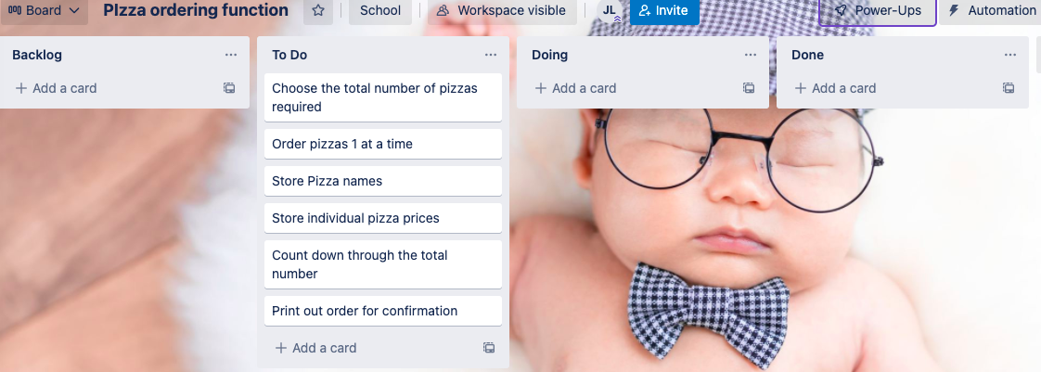
Component 6 v1 Pizza Order (Trello screenshot)

Slide 38
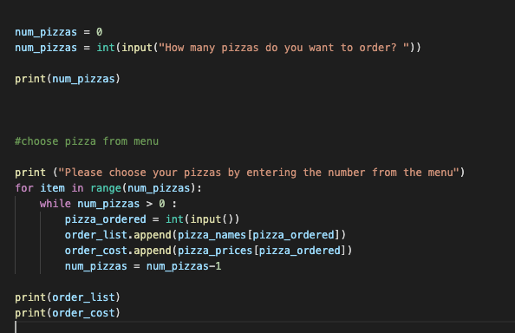
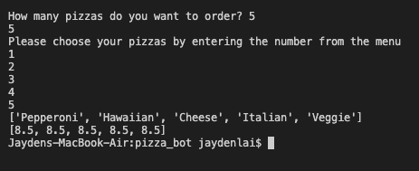
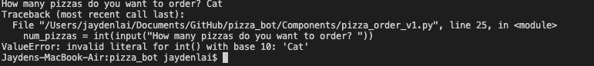
Component 6 v1- Test Plan
Test Case | Expected Values
Entered 5 pizzas Entered Cat | Stepped through the menu choice 5 times Program broke

Slide 39
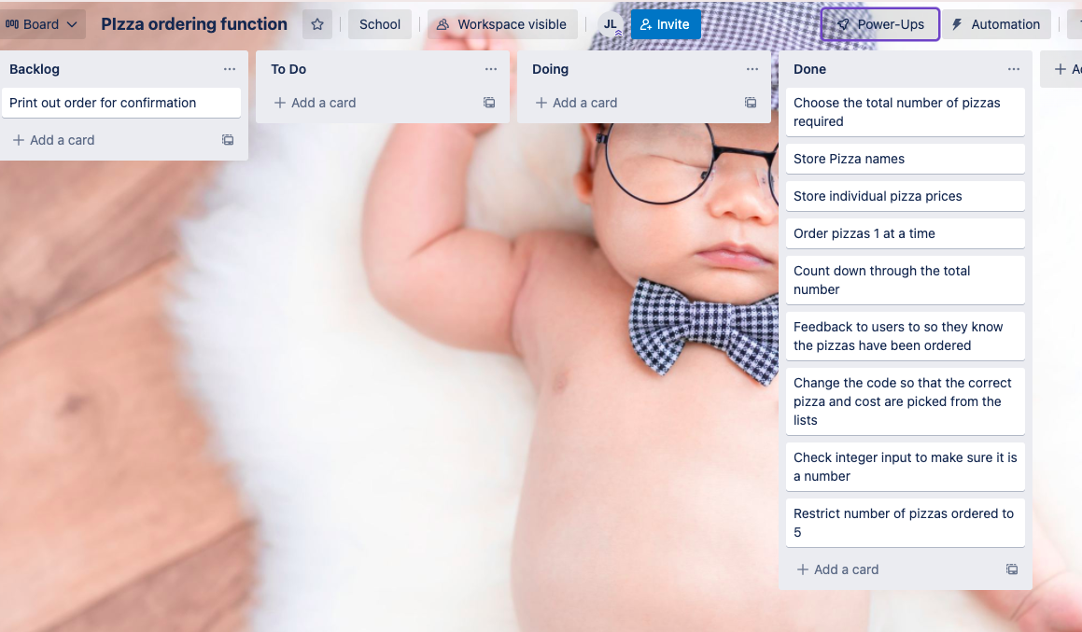
Component 6 v2 Pizza Order (Trello screenshot)

Slide 40
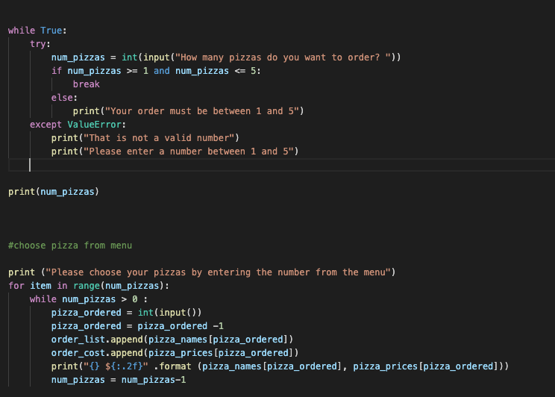
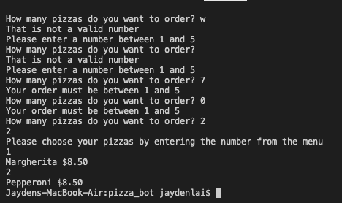
Component 6 v2- Test Plan
Test Case | Expected Values
W Space 7 0 2 | Not a valid number Not a valid number Must be between 1 and 5 Must be between 1 and 5 Accepted

Slide 41

Component 6 v3 Pizza Order (Trello screenshot)

Slide 42


Component 6 v3- Test Plan
Test Case | Expected Values
13 2 4 | Not a valid number Accepted

Slide 43

Component 6 v3 Pizza Order (Trello screenshot)

Slide 44

Component 6 v3- Test Plan
Test Case | Expected Values
13 2 4 | Not a valid number Accepted

Slide 45
Version Control Evidence
Your version control evidence should go here. This could be in the form of annotated screenshots which show you you managed this process or you could make a brief screencast explaining how you implemented version control.
Notes:
Your version control evidence should go here. This could be in the form of annotated screenshots which show you you managed this process or you could make a brief screencast explaining how you implemented version control.

Slide 46
Discusses how the information from planning, testing and trialling of components assisted in the development of a high-quality outcome
Notes:
Discusses how the information from planning, testing and trialling of components assisted in the development of a high-quality outcome

